Slide 1

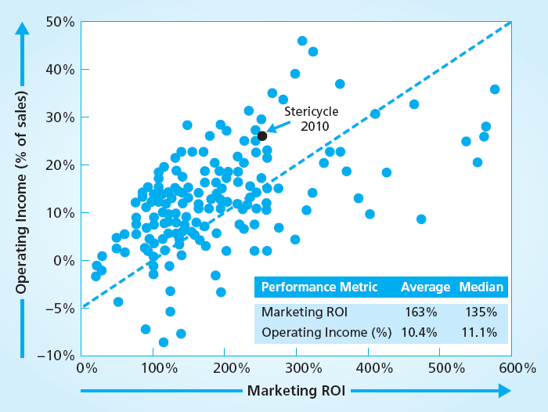
Market-Based Management and Financial Performance
MBM6
Chapter 16
Stericycle Marketing ROI
Vs. Operating Income
Chapter 16 Objectives
Marketing Profitability Metrics
Marketing Profits and Financial Metrics
Marketing Profits and Company Stock Price
This company has increased its stock price 80X in the last 15 years.
Copyright Roger J. Best, 2012

Slide 2
Market-Based Management and Financial Performance
MBM6
Chapter 16
Marketing Profitability
& Financial Performance
This section focuses on the ways in which marketing profits contribute to financial performance.
Copyright Roger J. Best, 2012

Slide 3
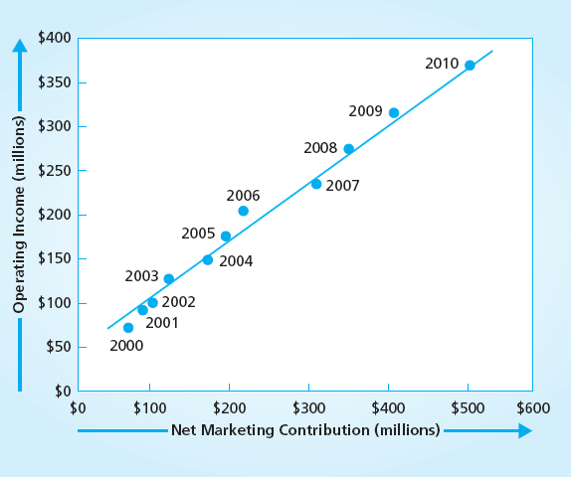
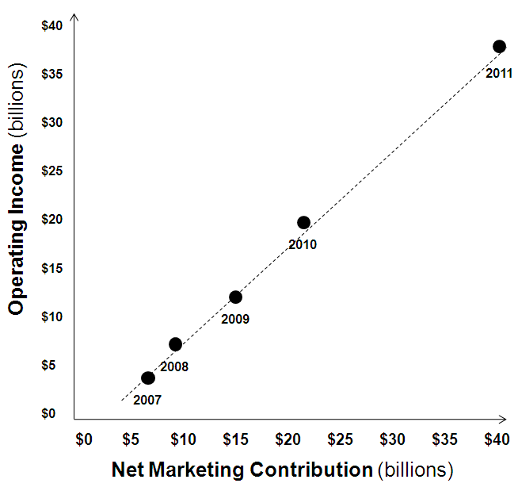
Net Marketing Contribution vs. Operating Income
MBM6
Chapter 16
Stericycle
Apple
2011
In 2011 Stericycle net marketing contribution was $568 million and operating income was $424 million.
Copyright Roger J. Best, 2012

Slide 4
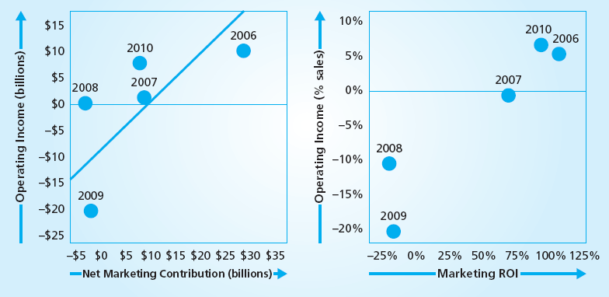
GM Net Marketing Contribution vs. Operating Income
MBM6
Chapter 16
Why is the GM Net Marketing Contribution less correlated with Operating Income?
How well did Marketing ROI correspond with Operating Income as a percent of sales?
Copyright Roger J. Best, 2012

Slide 5
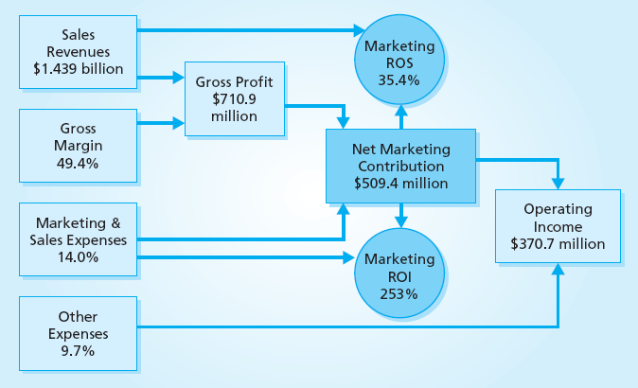
Marketing Profitability Metrics
MBM6
Chapter 16
There are three ways marketing and product managers can demonstrate and communicate marketing profits in financial terms.
Copyright Roger J. Best, 2012

Slide 6
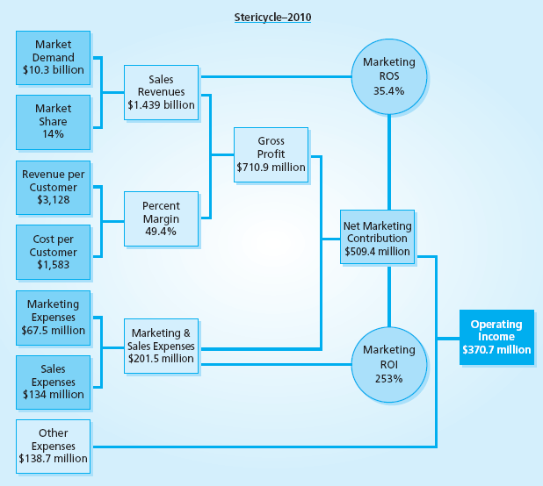
Marketing Model of Marketing Profitability Metrics
Marketing Performance Tool 16.1
This model of marketing profits includes many of the factors that drive marketing profitability,
Market Demand
Market Share
Revenue per Cost
Cost per Customer
Percent Margin
Marketing Expenses
Sales Expenses
Copyright Roger J. Best, 2012

Slide 7
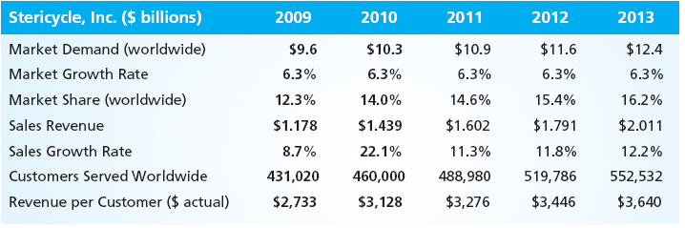
How Marketing Contributes to Sales Growth
MBM6
Chapter 16
Stericycle above average rate of sales growth is driven by:
A medical waste disposal market that is growing at 6.3% per year
Increasing market share and number customers served worldwide
A steady increase in Revenue per Customer
Copyright Roger J. Best, 2012

Slide 8
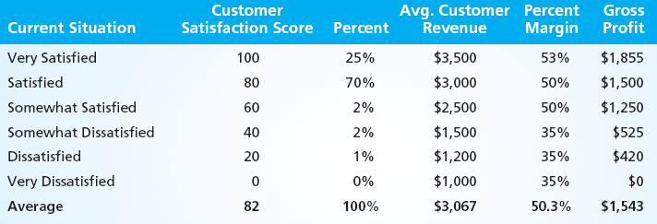
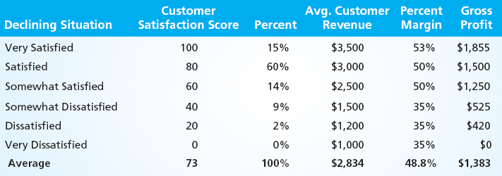
Why Businesses with Higher Customer Satisfaction Are More Profitable
MBM6
Chapter 16
Customer Satisfaction Index 82 and 25% “Very Satisfied”
Higher levels of customer satisfaction contributes to:
Higher average rev. per customer.
Higher percent margins.
Higher gross profit per customer.
Customer Satisfaction Index 73 and 15% “Very Satisfied”
Copyright Roger J. Best, 2012

Slide 9
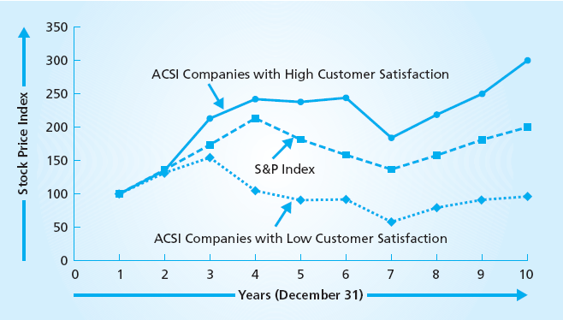
Company Customer Satisfaction and Stock Price
MBM6
Chapter 16
ACSI – America Customer Satisfaction Index (www.theACSI.com)
Companies with Higher Customer Satisfaction scores produce high rates of stock appreciation that companies with low levels.
Copyright Roger J. Best, 2012

Slide 10
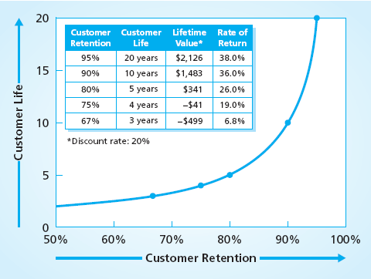
Why Customer Retention Corresponds to Profitability
MBM6
Chapter 16
Lifetime Customer Value (Using 20% Discount Rate)
$950 Annual Net Cash Flow
……..
1 2 3 4 5 6 7 8 9 10 20
Customer Life (years)
$2500 Acquisition Cost
The rate of return on the customer cash flow exponentially with customer retention. Why?
Copyright Roger J. Best, 2012

Slide 11
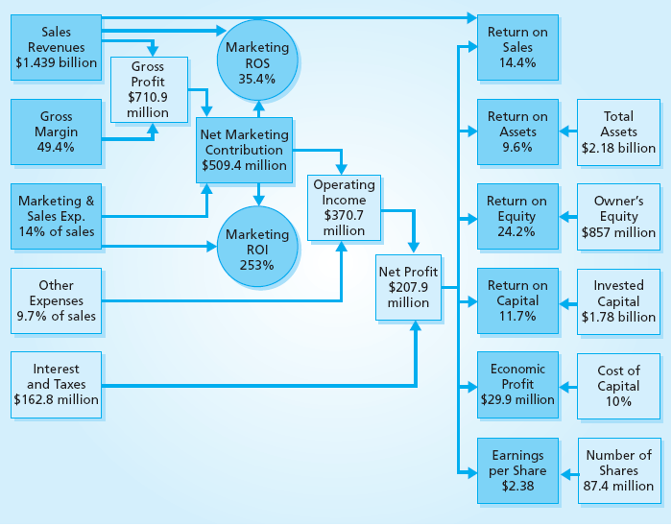
Marketing Profitability Metrics and Financial Metrics
MBM6
Chapter 16
How would the financial metrics shown change if the net marketing contribution decreased by 10%?
Copyright Roger J. Best, 2012

Slide 12
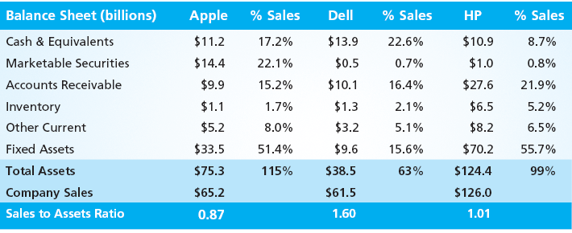
How Market-Based Management Impacts Assets & Return on Assets
MBM6
Chapter 16
How do marketing strategies impact accounts receivable and inventory? Why is a high sale-to-asset ratio good?
Copyright Roger J. Best, 2012

Slide 13
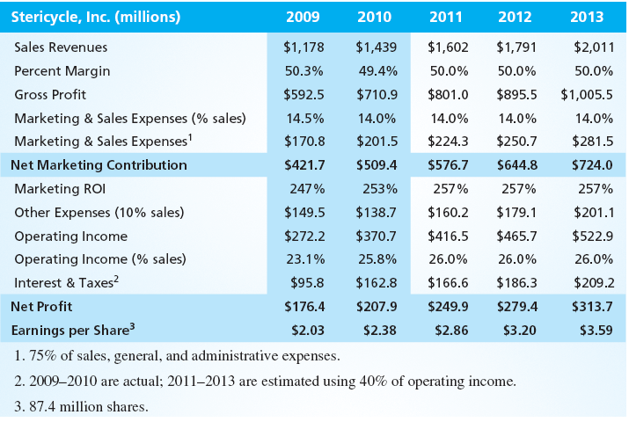
Financial Forecast That Includes Net Marketing Contribution
MBM6
Chapter 16
Copyright Roger J. Best, 2012

Slide 14
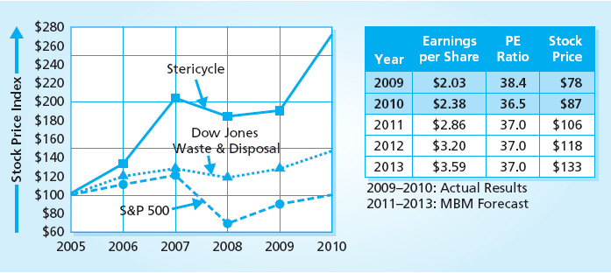
Forecasting Stericycle Stock Price
MBM6
Chapter 16
Stericycle has outperformed Dow Jones Waste & Disposal companies and S&P 500 average from 2005 to 2010.
Copyright Roger J. Best, 2012

Slide 15
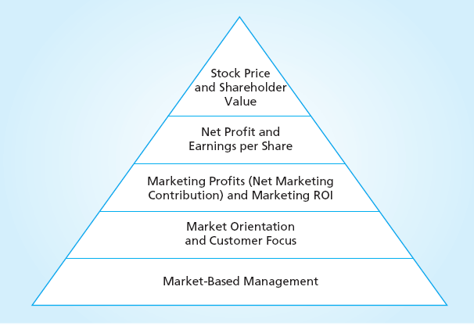
Market-Based Management and Financial Performance
MBM6
Chapter 16
Market-Based Management and a strong Customer Focus is how marketing, sales and product managers contribute to above average performance.
Copyright Roger J. Best, 2012

